Slide 1



Slide 2
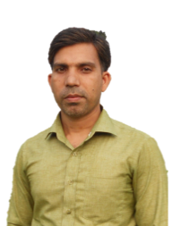
Introducing
Mohammed Abdur Rashid
Assistant Teacher
Kamalpur Hazi Jonab Ali GPS
Bhairab, Kishoreganj
Class: Three
Subject: English
Lessons: 1-3
Unit: 5
Time:40 Minutes

Slide 3

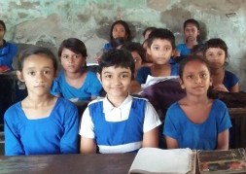
Good morning, students.
Good morning, teacher.
How are you today?
Fine. and you?
Fine, thank you.

Slide 4
Let’s enjoy a video.

Slide 5
Today's lesson
Commands and instrutions

Slide 6
Students will be able to
Listening: 2.1.1- carry on commands and instructions.
Speaking: 1.1.1- repeat words, phrases and sentences
after the teacher with proper sounds and stress.
1.1.2- say words, phrases and sentences with proper
sounds and stress.
Learning outcomes
Reading: 1.5.1- read simple sentences with proper
pronunciation and stress.

Slide 7
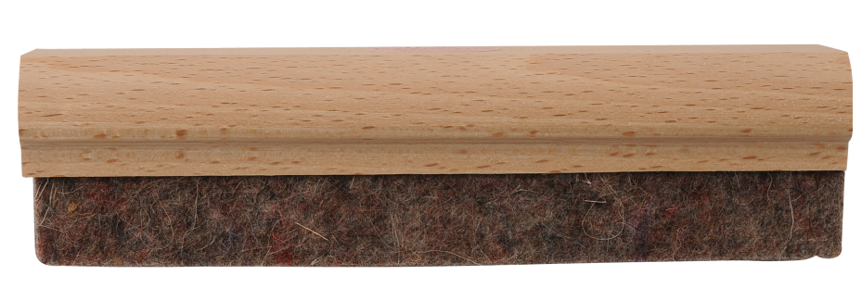
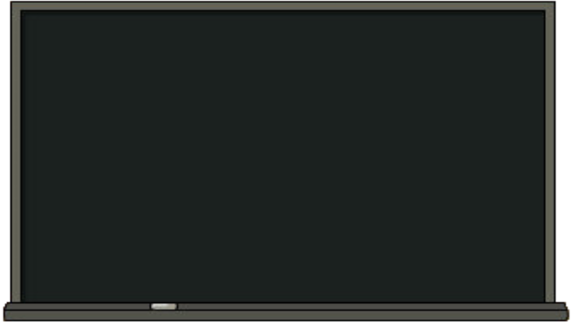
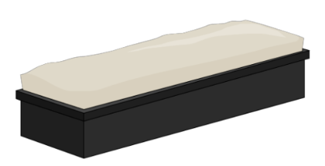
What do you see in the picture?
board
duster

Slide 8


What do you see in the picture?
chalk.
flag

Slide 9
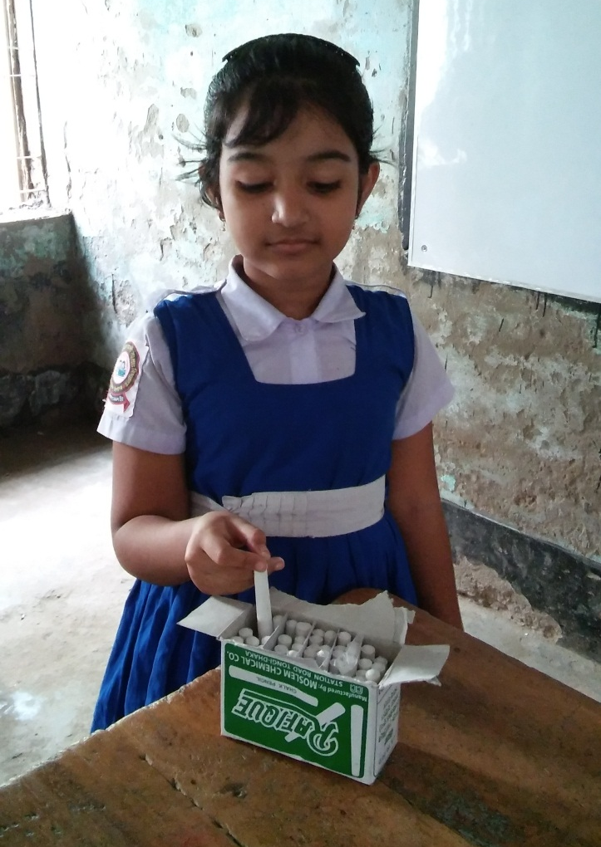
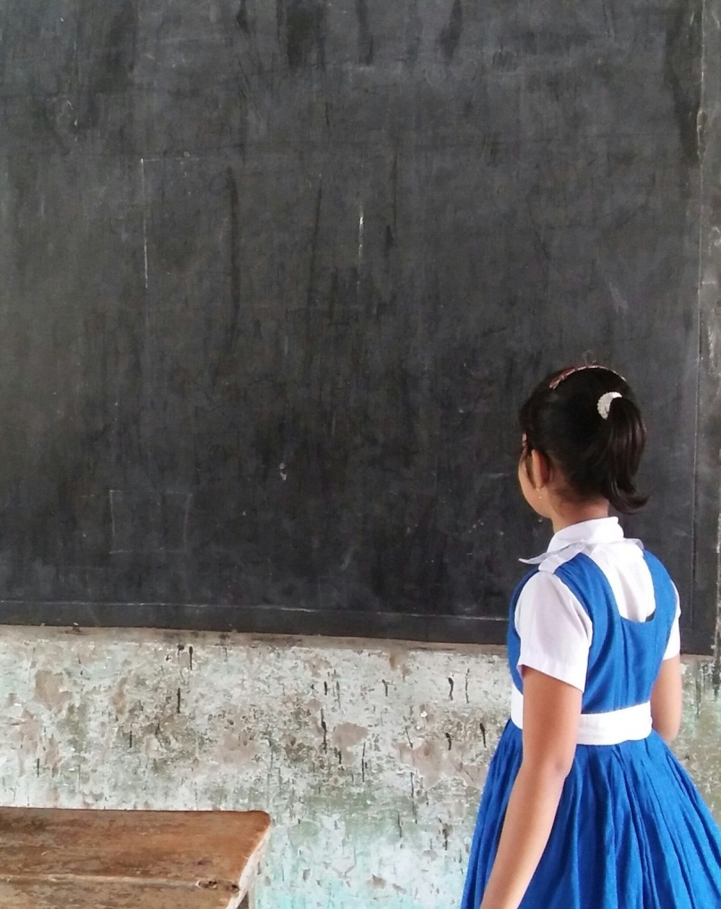
What do you see in the picture?
Take the chalk.
Go to the board.

Slide 10
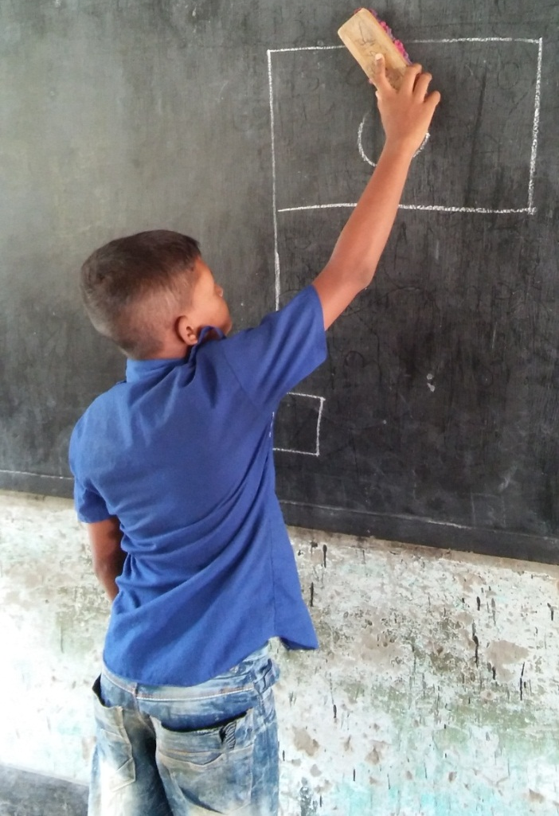
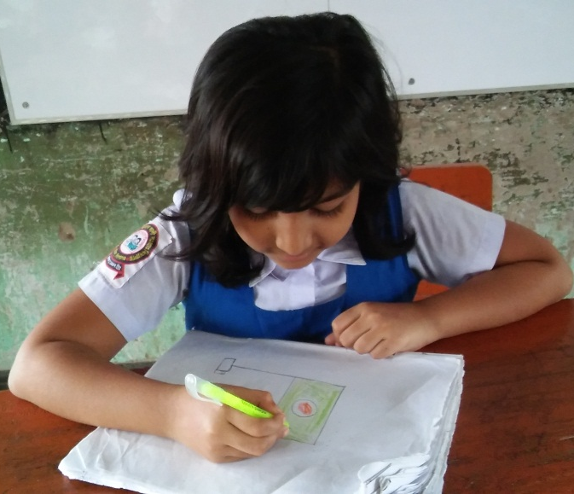
What do you see in the picture?
Clean the board with the duster.
Draw our flag.

Slide 11
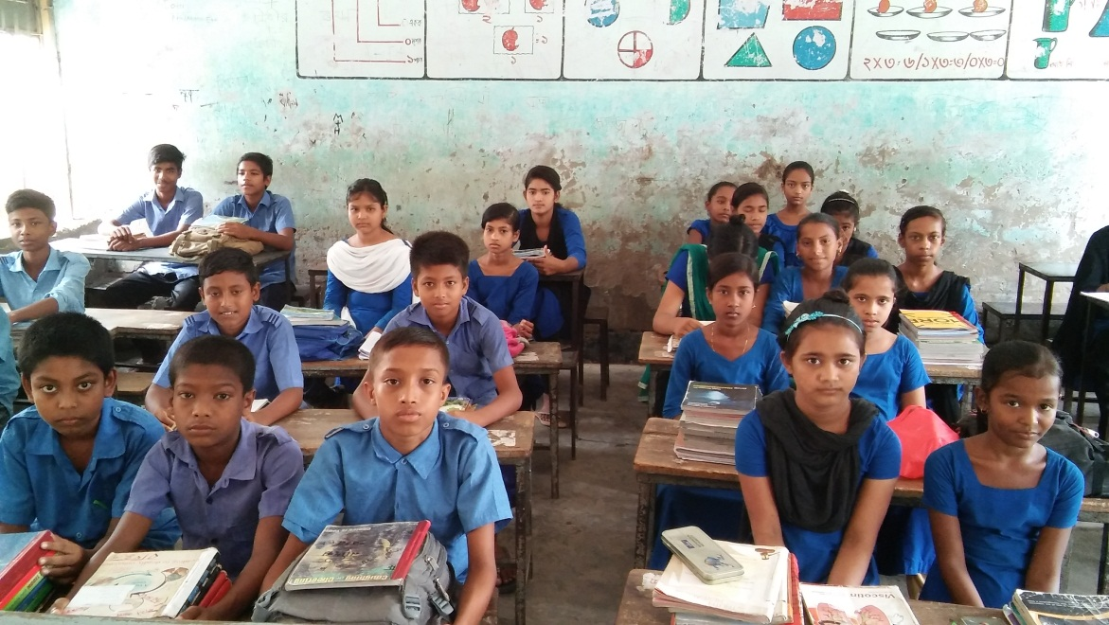
Everybody listen and do after me.
Take the chalk.
Go to the board.
Clean the board with the duster.
Draw our flag.

Slide 12
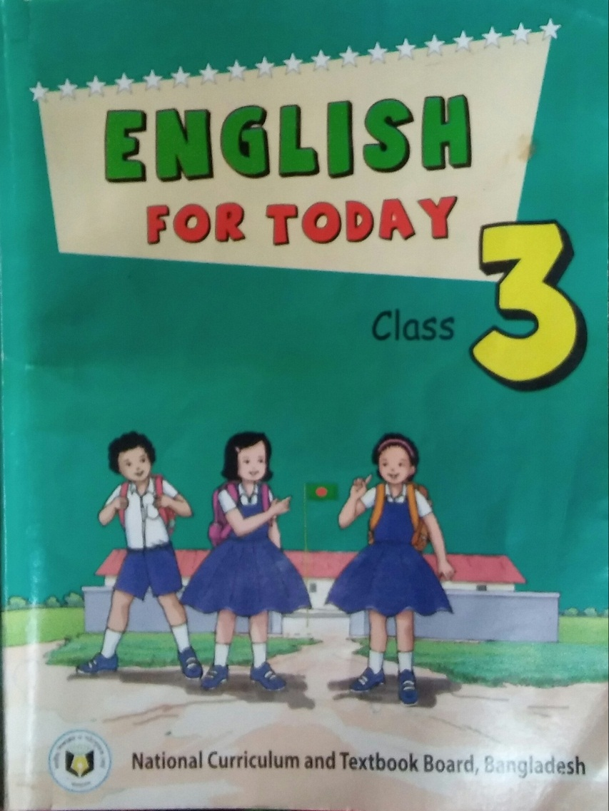
Open your book at page 10.

Slide 13

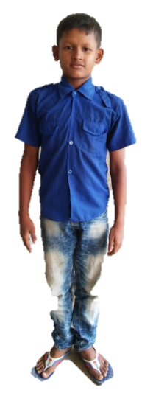
Student’s doing the instructions
Stand up.
Exercise.
Take the chalk.
Go to the board.
Clean the board with the duster.
Draw our flag.
Go to your seat.

Slide 14

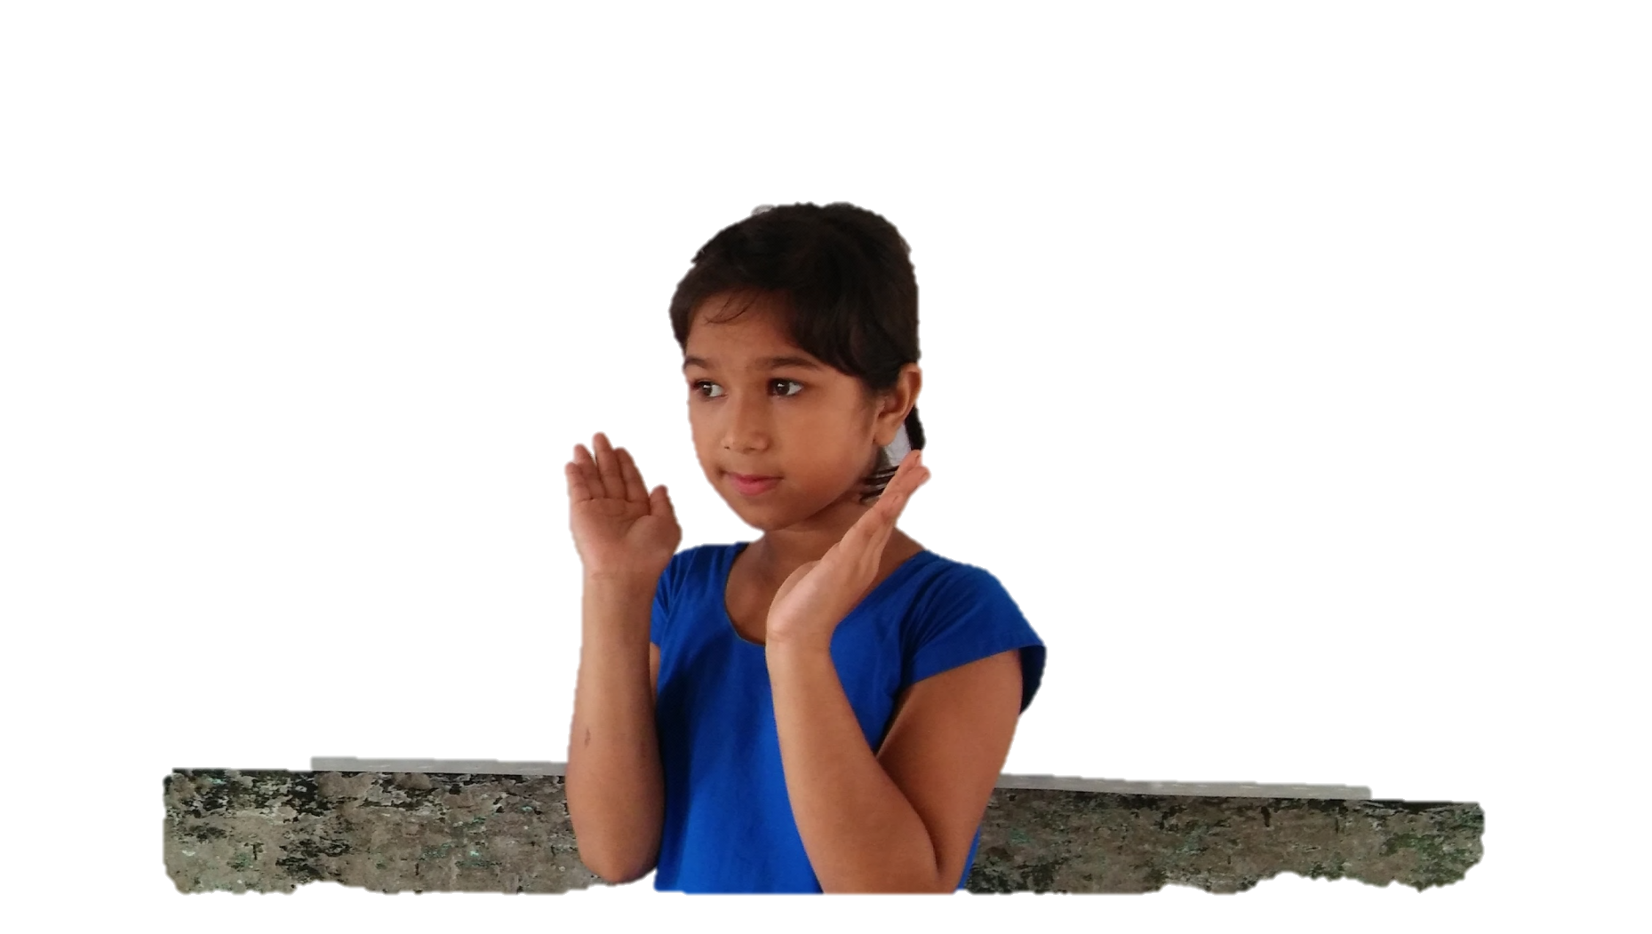
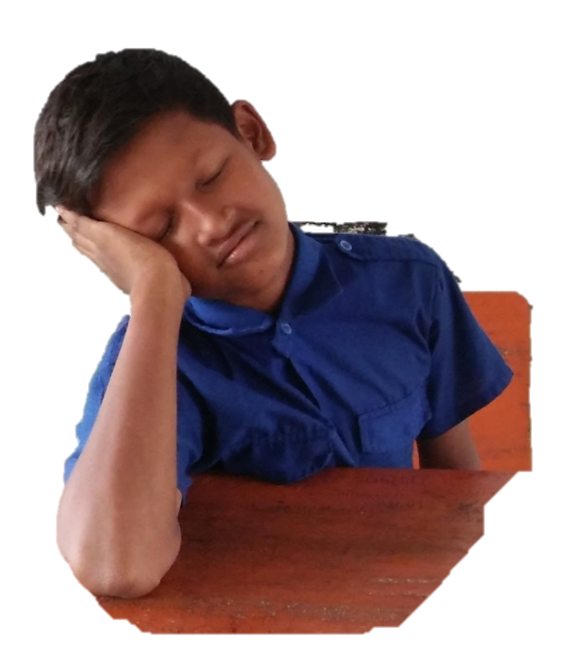
Group work
Five students in a group and say the commands about these picture.
. . . . . .
. . . . . .
. . . . . .
. . . . . .

Slide 15

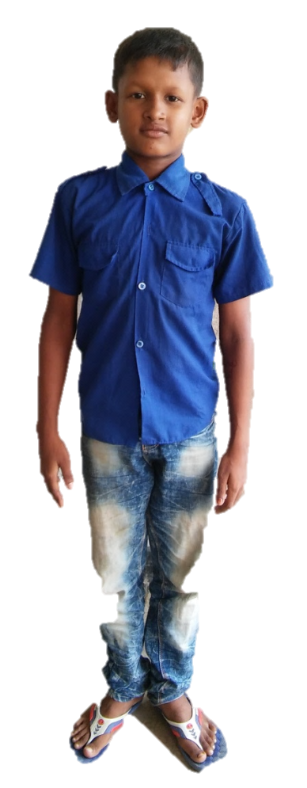
Pair work
Two students come and say some common command with each others.

Slide 16




Evaluation
Look at the pictures and say the commands and instructions about these.

Slide 17


